Slide 1
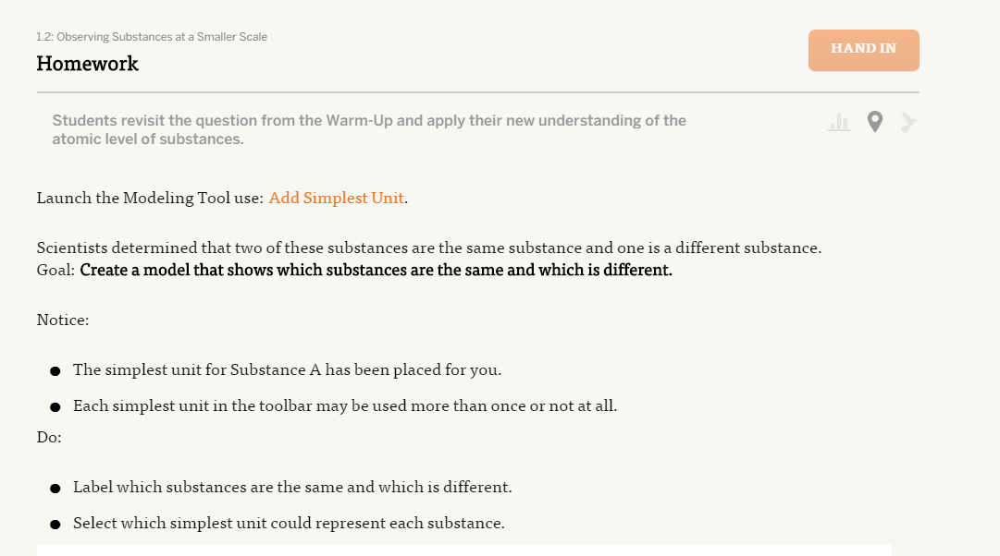
This is HW for 1.2---I am sure some others will follow this procedure.
Click on this to launch this– is one of several
Titles used.

Slide 2
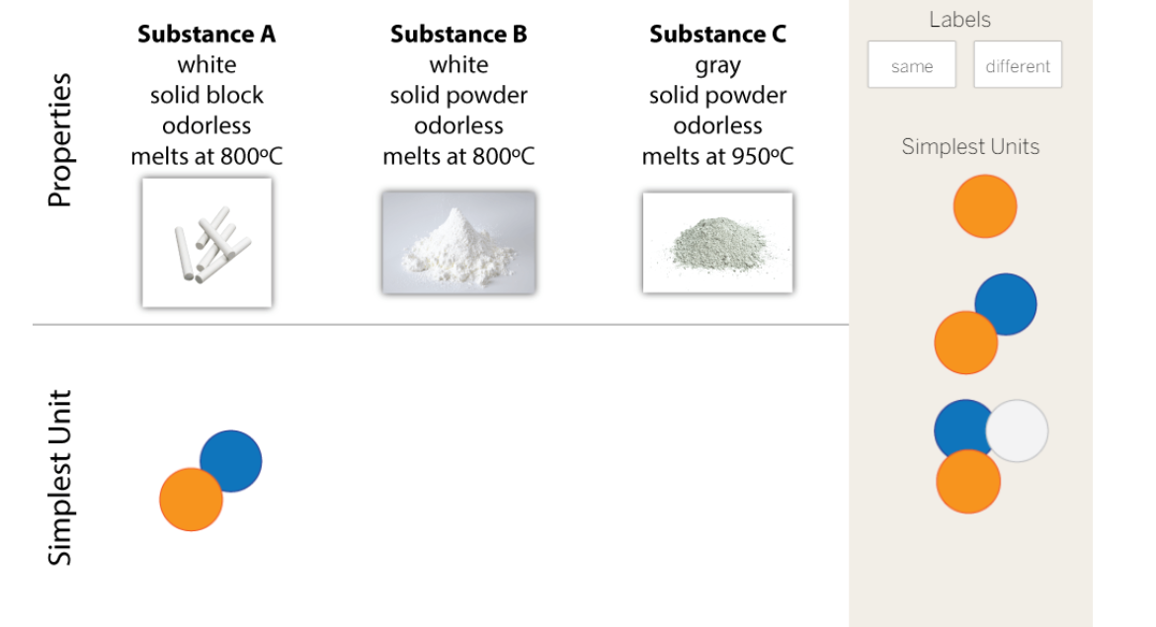
This is the screen that comes up. The students will drag the labels to the proper place.

Slide 3
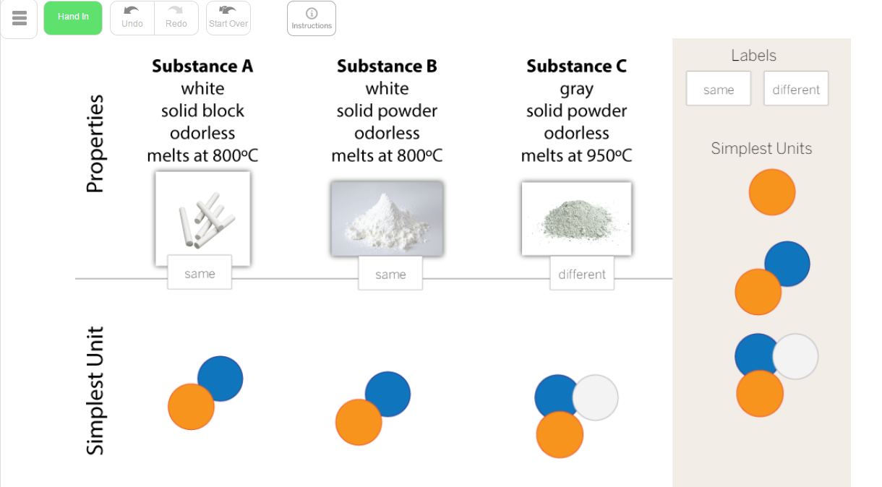
Then they must take a screen shot:
PC-use snipping tool iPads-push home and power buttons simultaneously

Slide 4
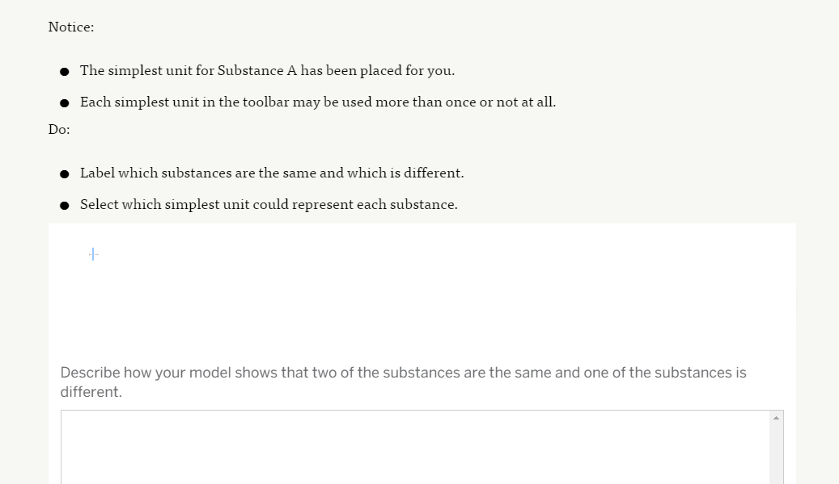
Now they will have to upload the image. Click upload. Find the pic:
PC in pictures iPads in the camera roll
Then answer question about the uploaded image.
Upload

